Slide 1
Big Data and Geospatial Analysis in Agriculture and Environment
Takaaki Masaki
Revocatus Paul

Slide 2
Overview of the workshop
Date | Theme
Day 1 (April 22) | Introduction to Big Data, GIS, and R programming
Day 2 (April 23) | Advanced topics in GIS
Day 3 (April 24) | Introduction to Geospatial Data on Environment and Agriculture
Day 4 (April 25) | Integrating Survey Data with Geospatial Data
Day 5 (April 26) | Group study proposal presentation
Day 6 (April 29) | Introduction to GitHub and Google Earth Engine
Day 7 (April 30) | Group study presentation

Slide 3
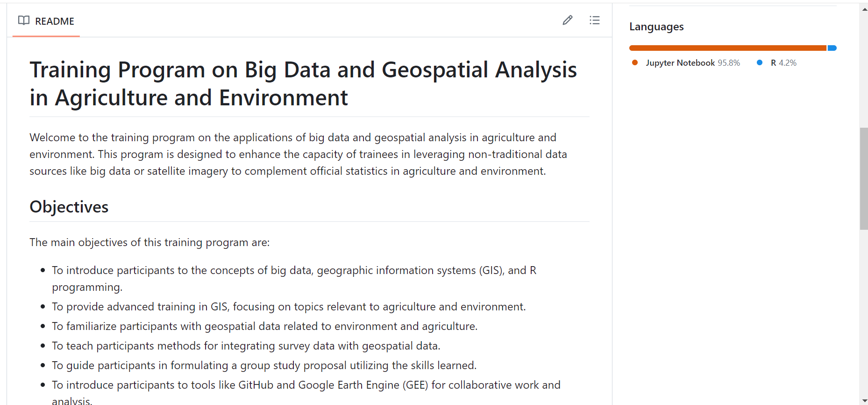
Overview of the workshop
https://github.com/takaakimasaki/tanzania_spatial_training_2024

Slide 4
Brief introduction
Name
Organization
Reasons for taking this course
Any topics that you would like us to cover during the workshop?

Slide 5
day 1: Introduction to Big Data, GIS, and R programming
Takaaki Masaki
Revocatus Paul

Slide 6
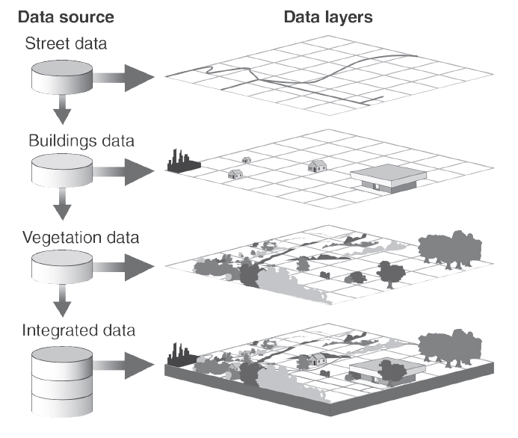
What is big data?
Big Data is defined by volume, velocity and variety — large amounts of data coming in quickly in a number of formats.
Geospatial data is a crucial component of big data, adding context that allows for better, multidimensional insights that facilitate smarter decisions, improved business operations and innovation to deliver a strong competitive advantage.

Slide 7
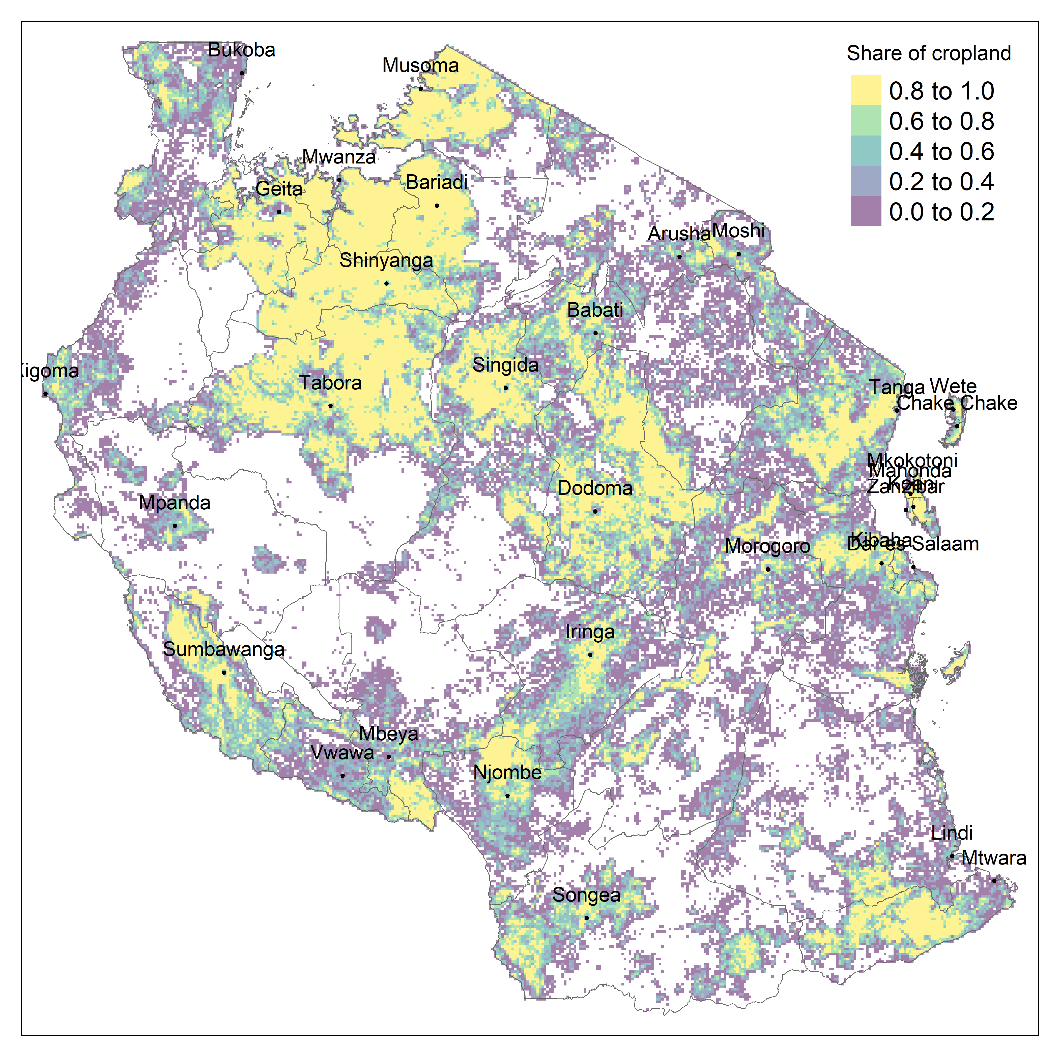
Agricultural and environmental statistics through the lens of big data
“Geospatial information adds significant value and utility to environment statistics. Ideally, geographic aspects of data should always be collected, represented and analysed at the most detailed scale possible, based on national capacities and priorities” (FDES 2013)
Notes:
https://unstats.un.org/unsd/environment/FDES/FDES-2015-supporting-tools/FDES.pdf

Slide 8
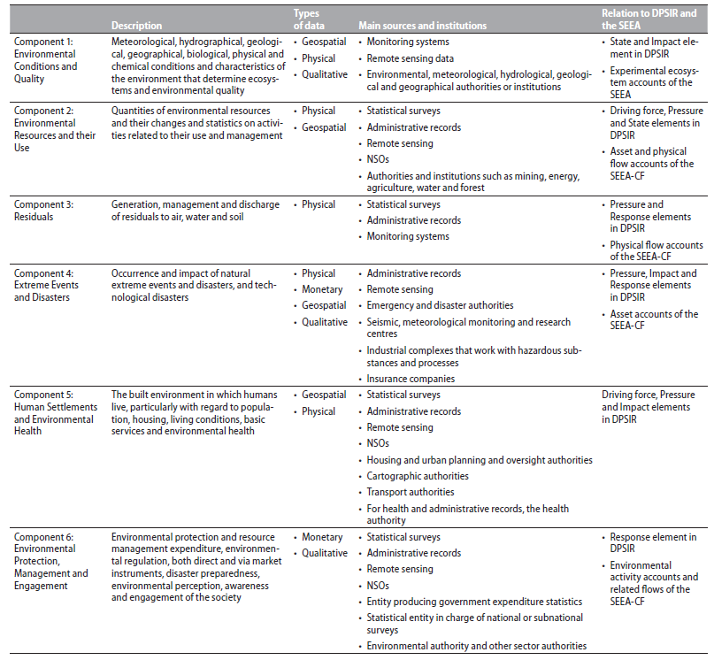
Table: Main attributes of the components of the FDES
Notes:
https://unstats.un.org/unsd/environment/FDES/FDES-2015-supporting-tools/FDES.pdf

Slide 9
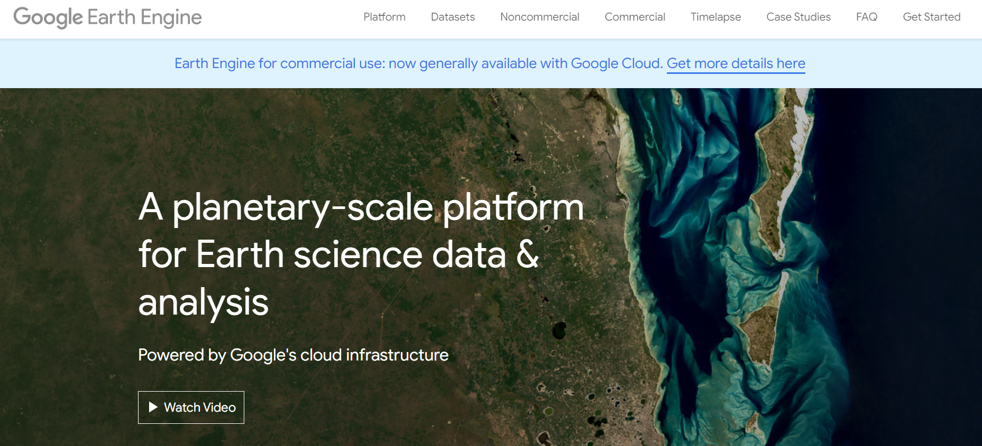
There is so much geospatial data out there!
Google Earth Engine (GEE) has over 50 petabytes of data, including 900 datasets and over 30 years of historical imagery (1P = 1000T = 1,000,000 GB)

Slide 10
Example 1: ESRI Land Cover

Slide 11
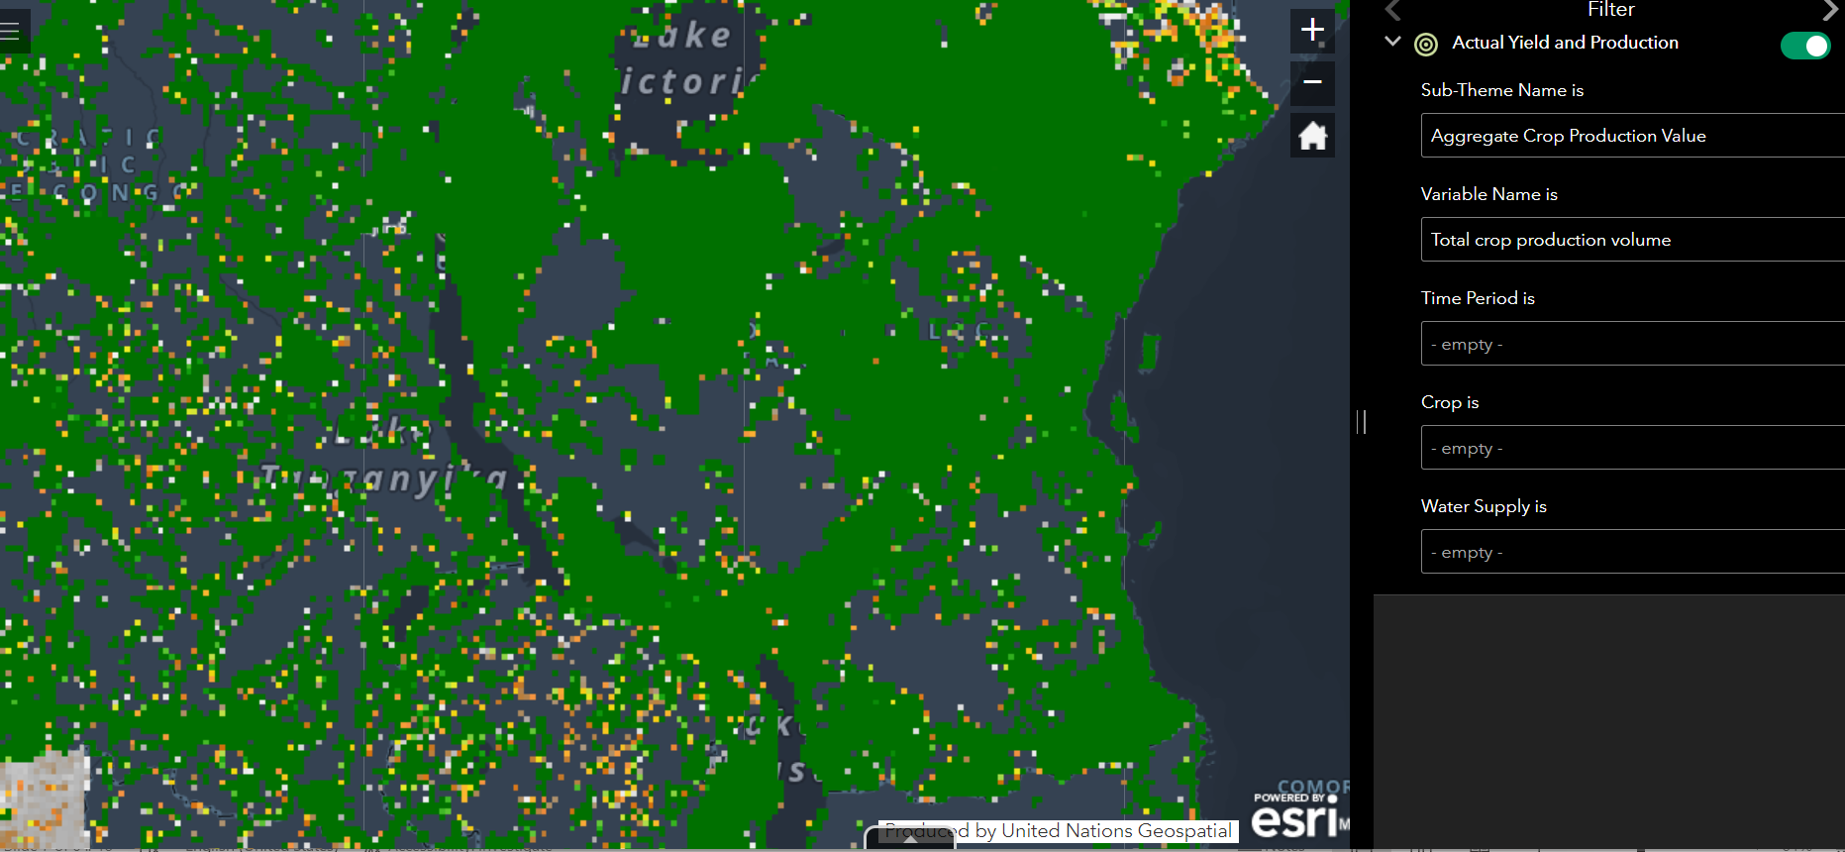
Example 2: GAEZ Version 4

Slide 12
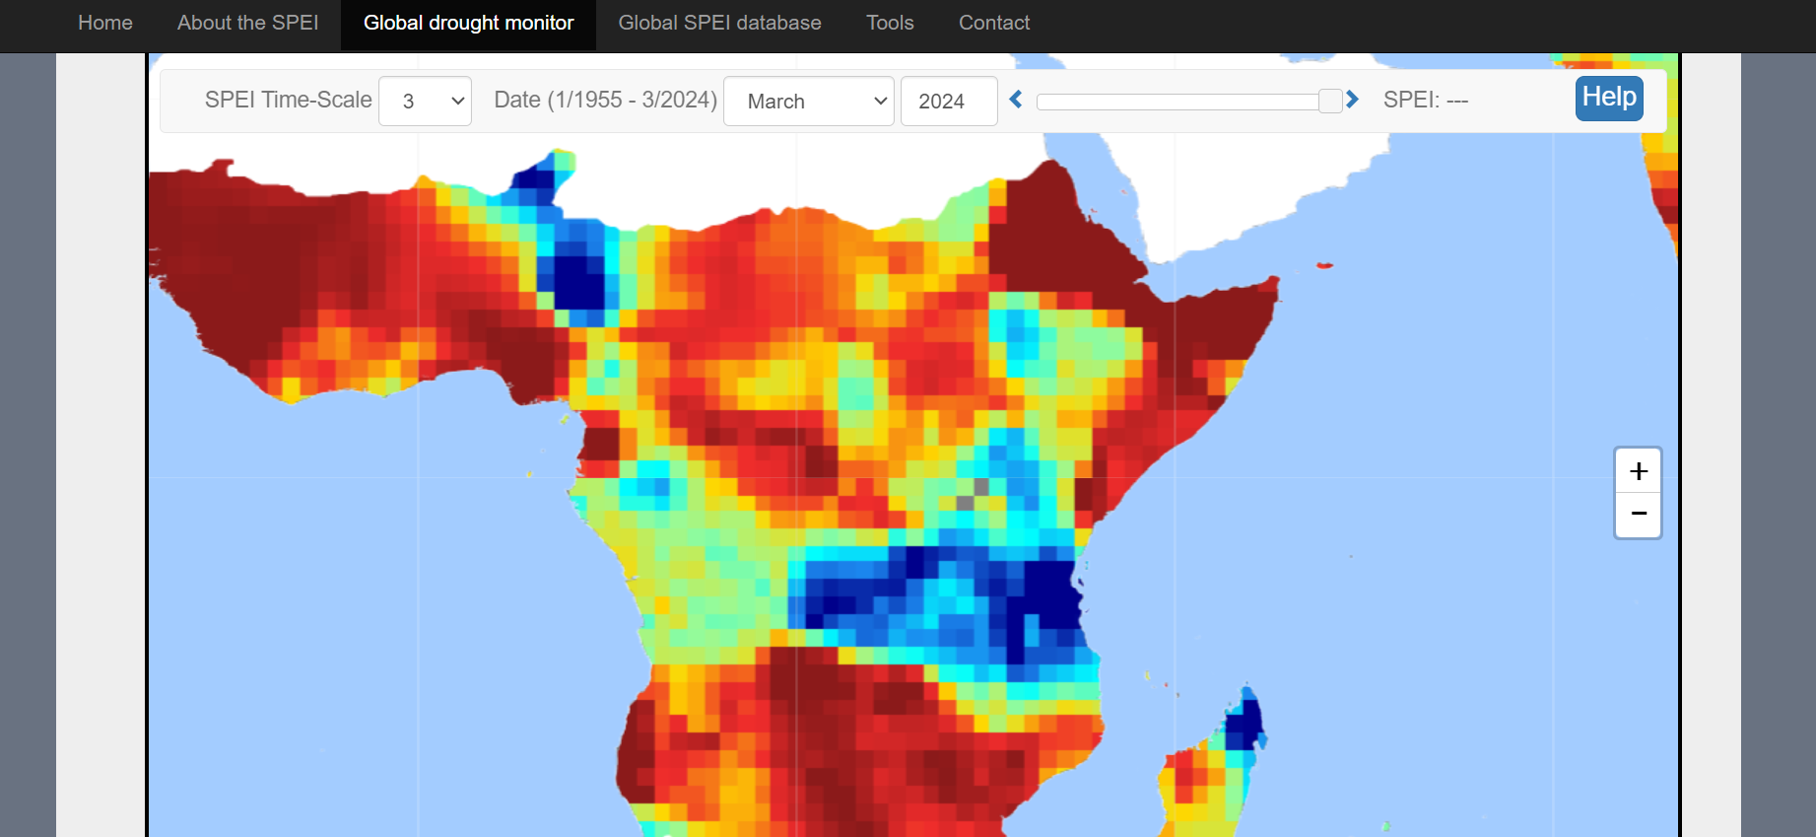
Example 3: SPEI Global Drought Monitor

Slide 13
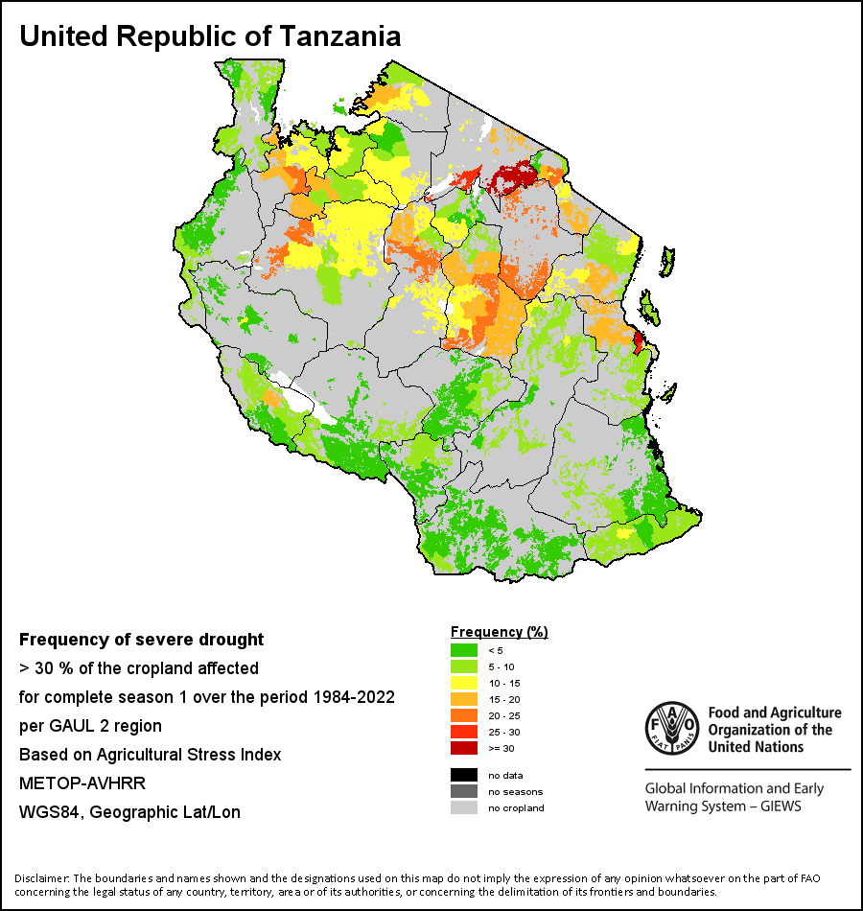
Monitoring drought in Tanzania through the Agricultural Stress Index (ASI)
The ASI is a quick-look indicator that facilitates the early identification of cropped land with a high likelihood of water stress (drought).

Slide 14
GIS and Spatial Analysis

Slide 15
Different types of spatial data

Slide 16
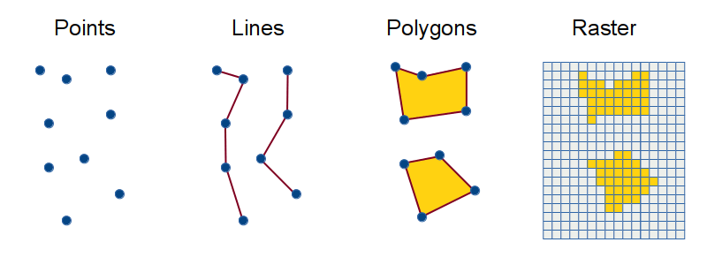
Different types of spatial data
Examples:
Schools
Hospitals
Roads
Railway
Country/region/district boundary
Population density
Rainfall
Temperature

Slide 17
GIS file formats

Slide 18
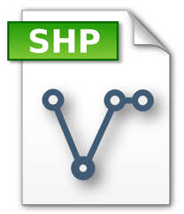


GIS file formats
File formats | Shapefile | netCDF & GEOTIFF
Data Types | Point & Line & Polygon | Raster

Slide 19
Shapefile
A shapefile is a vector data format that stores the location, geometry, and attributes of geographic features, such as points, lines, and polygons.
Let’s say you would like to generate a map of Tanzania
Download the shapefile of administrative boundary from HDX
You will see a list of various files that make up a shapefile, including SHP, SHX, DBF, PRJ, XML, SBN, SBX, and CPG.
SHP is a mandatory Esri file that gives features their geometry.
SHX are mandatory Esri and AutoCAD shape index positions. This type of file is used to search forward and backward.
DBF is a standard database file used to store attribute data and object IDs.
PRJ is an optional file that contains the metadata associated with the shapefiles coordinate and projection system.
See more details on this topic on the ESRI website

Slide 20
Example: raster data (GEOTIFF, TIFF, netCDF)
Raster data comes in the form of GEOTIFF, TIFF, or netCDF
TIFF: Adobe Tagged Image File Format (TIFF or TIF, same thing) is so universally used as a format for imagery. TIF files can contain tags, additional items of information, that can be used to extend the standard for different purposes
GEOTIFF: A GeoTIFF is a TIF file that ends in a three letter . tif extension just like other TIF files, but a GeoTIFF contains additional tags that provide projection information for that image as specified by the GeoTIFF standard.
netCDF: Network Common Data Form (netCDF) is a file format for storing multidimensional scientific data (variables) such as temperature, humidity, pressure, wind speed, and direction

Slide 21
Examples of vector/raster datasets in different formats: 1-lecture_code.R

Slide 22
Coordinate systems

Slide 23
Coordinate systems
https://www.youtube.com/watch?v=Z41Dt7_R180

Slide 24
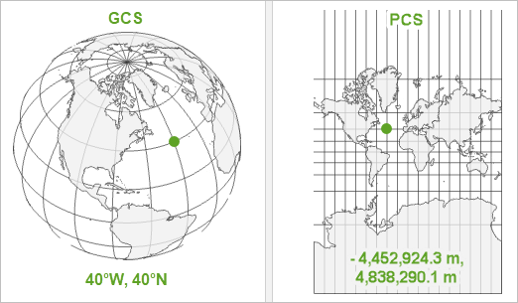
Coordinate systems
Geographic Coordinate System
Projected Coordinate System
Shape: Spherical
Unit: Degree (Longitude & Latitude)
Example: WGS84 (EPSG:4326)
Shape: Flat
Unit: Meter (X & Y)
Example: Pseudo-Mercator (EPSG:3857)
There are many coordinate reference systems (CRS) (i.e., standards for describing locations) based on the two systems above.
So, it’s important to check coordinate reference systems before analysis.
Notes:
See more on this: https://www.e-education.psu.edu/geog160/node/1918
See more on https://www.joaoleitao.com/different-world-map-projections/

Slide 25
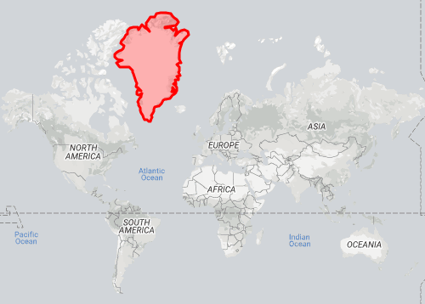
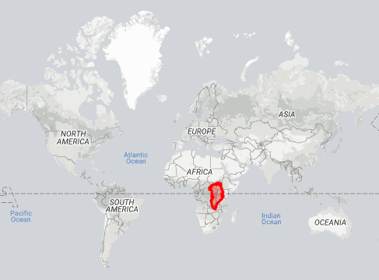
Getting projection right

Slide 26
GIS Analysis Software

Slide 27




GIS Analysis Software
Python
- Programming language
- General purpose
- Open-source (free to use)
ArcGIS
- Software
- Built for GIS analysis
- Proprietary software (NOT free to use)
R
- Programming Language
- Focused on statistical analysis
- Open-source (Free to use)
QGIS
- Software
- Built for GIS analysis
- Open-source (free to use)

Slide 28
Introduction to R programming

Slide 29
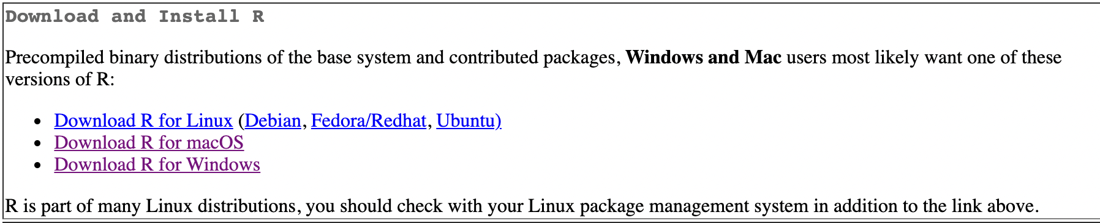
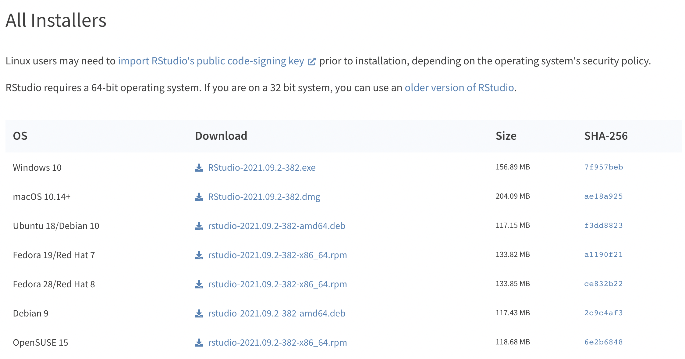
How to install R and RStudio
1. Install R
2. Install RStudio
Go to https://cran.r-project.org/
Download the latest version of R for your computer
Go to https://www.rstudio.com/products/rstudio/download/#download
Download the latest version of R for your computer

Slide 30
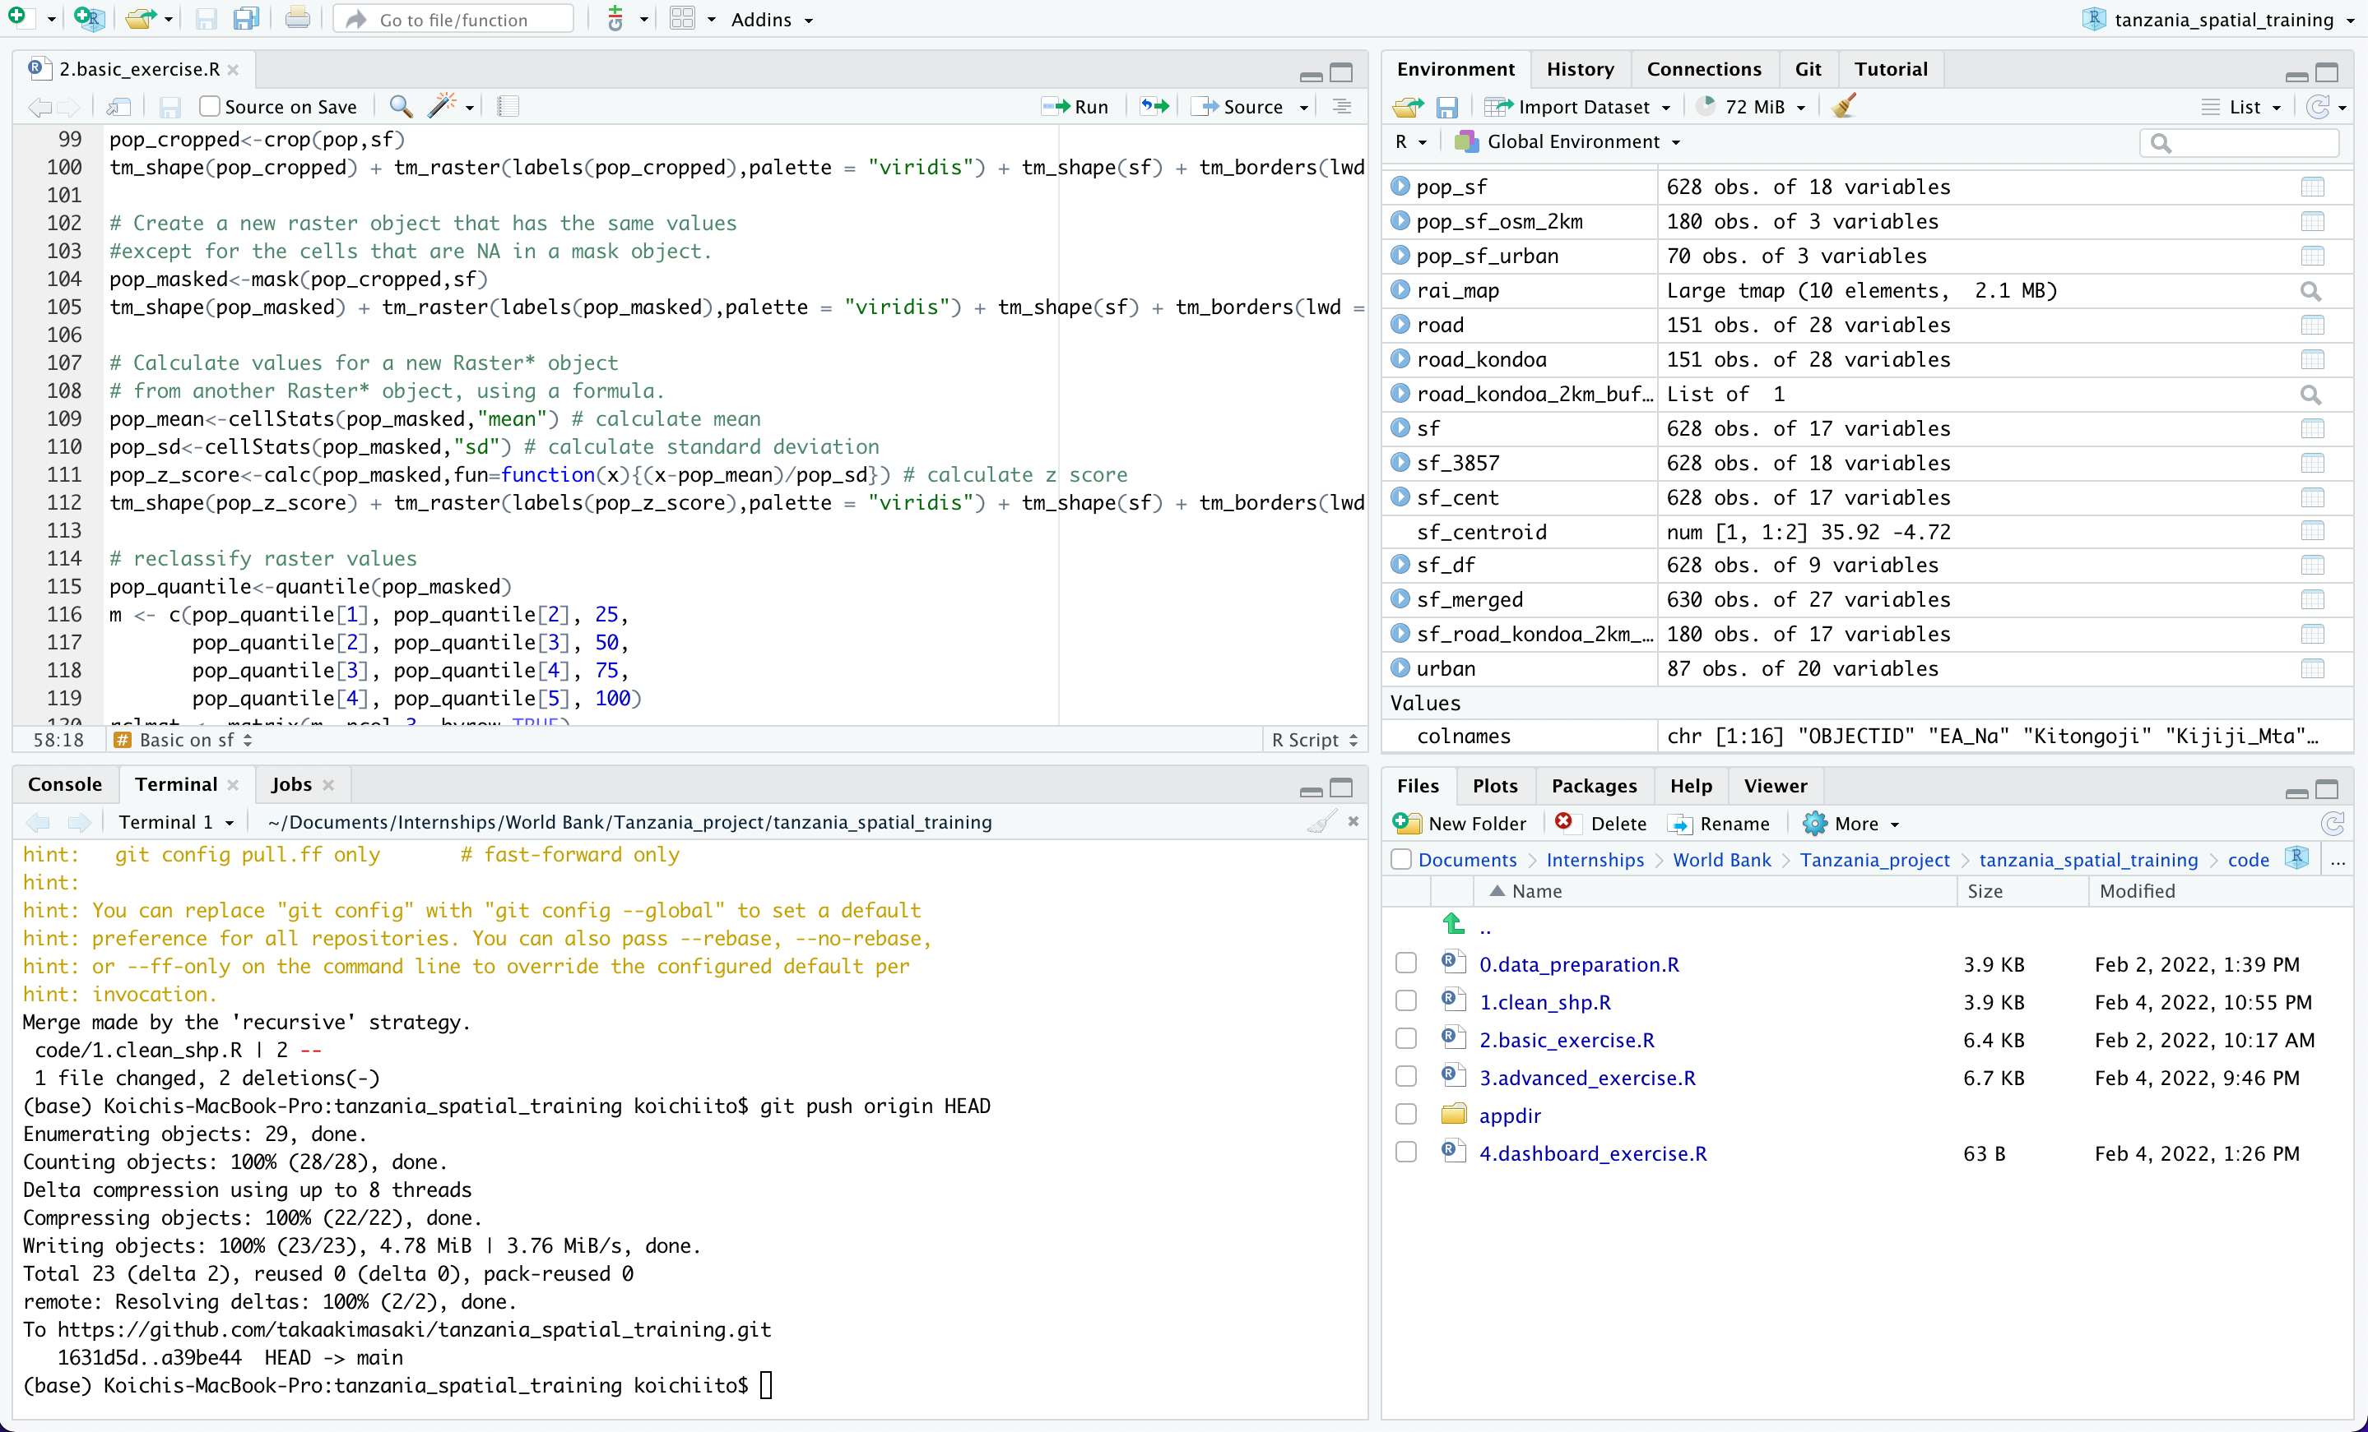
Basic user interface of RStudio
This is where you code
This is where you can see variables and command history
Source
Environment/
History
Console/ Terminal
Files/Plots/ Packages/Help
This is where your code is evaluated by R
This is where you can check files, plots, packages and help from R

Slide 31
1_handson.R
Hands-on exercise
In this exercise, you will learn:
Basics in R programming
How to read shapefile and raster files
How to manipulate these datasets (using dplyr package)
Generate basic maps (using plot function)

Slide 32
Q&A

